Slide 1

Semester – 6
Mini Project: EC-604
Automating Run Out
Decision In Cricket Using
Image Processing & ML Model
Submitted by
Roll No.: UI22EC22 (Dhruv Kumar Meena)
Roll No.: UI22EC01 (Abhishek Tiwari)
Under the guidance of
Dr. Shriman Narayan
(Faculty Supervisor)

Slide 2
Current Scenario :
In cricket, when there is a close run-out with a direct hit, the third umpire checks slow-motion replays from different camera angles. They look at the exact moment the ball hits the stumps and see if the batter's bat or foot was inside the crease. LED stumps (called Zing bails) help by lighting up the moment they are broken. This helps the umpire know the exact time of impact. After watching the replays, the third umpire makes the decision and tells the on-field umpire, who then gives the final out or not out signal.

Slide 3
Human Error In Decision Making
Slow Decision Making Process.
Technology Limitations.
Problem :

Slide 4
Why ML Model Needed ?
AI-Powered Ball Tracking
Improved Accuracy & Speed
Real Time Decision Making

Slide 5
Our Objective :
Design a machine learning model to detect run-outs.
Eliminate the chance of human error.
Improve accuracy and reduce decision-making time.

Slide 6
Technologies Used:
The proposed system utilizes a combination of image processing and machine learning techniques to automate run-out decisions.
Key technologies involved include:
Image Processing Techniques: Methods such as edge detection, and absolute difference algorithm are employed to analyze frames and detect crucial moments of the run-out.
Machine Learning Models: Convolutional Neural Networks (CNN) is used to classify images and determine whether the batsman is inside or outside the crease.
Video Frame Analysis: Advanced video processing techniques help identify the exact frame where the bails are first dislodged, ensuring precision in decision-making.
Real-time Processing: The system is designed for real-time application, reducing delays in decision-making and minimizing interruptions in the game.

Slide 7
Software Used :
VS for coding part
Command Prompt for installing LabelImg
LabelImg Python (Annotation Software for doing annotation)
Pytorch(for modelling the image)

Slide 8
Architecture Workflow (for extracting frames) :
Capture video form
online sources
Cricket match videos from platforms like YouTube and Hotstar can be used for training.
Using python supported software for extracting frames from video
We use VS Code to write Python code for extracting video frames.
Installing LabelImg in command prompt
After extracting frames, we use LabelImg (annotation software) to label objects like Bat, Ball, Pitch Line, Disturbed Wicket, and Undisturbed Wicket.
The input is a video file.
A video is made up of frames (images).
Split the video into frames and save each frame as a PNG file for model training.
The code takes a video path as input and an output path to save the extracted frames.
This process is repeated for around 8000 frames so the AI model can learn and make its own decisions.

Slide 9
Screenshot of frames extracted

Slide 10
Installation process of LabelImg(Annotation Software)
Open Command Prompt (Win+R)
Install Python (if not installed)
Install LabelImg

Slide 11
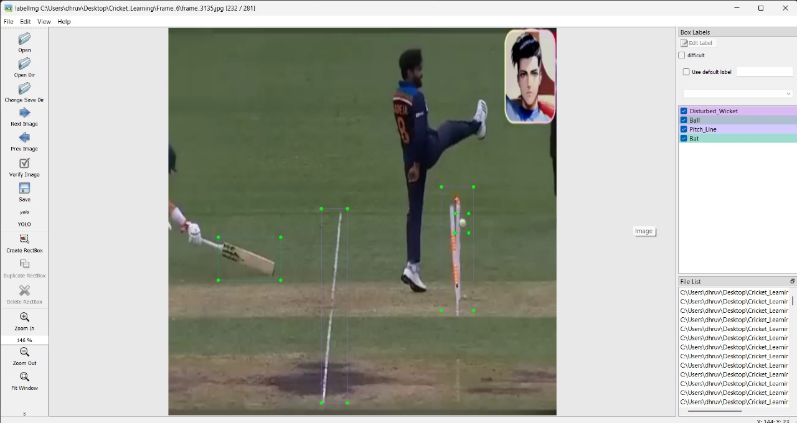
Annotating of frames in LAbelImg :
Process of Annotation in LabelImg Software
Manually drawing the rectangular region for bat, balls, pitch line and wicket. After the region is defined it is automatically save with labelled name in software.
The annotated frames are in saved in form of text files, we need to save those text files in particular directory,
Data of label is saved in coordinates in XML format

Slide 12

Machine Learning Model:
The CNN processes the image data to identify the batsman’s position with respect to the crease at the moment of bail dislodgement.
For this task, we used the ResNet architecture due to its high accuracy and ability to handle deep networks through residual connections. ResNet incorporates identity shortcuts to skip one or more layers, which helps mitigate the vanishing gradient problem and allows for training deeper models. The residual blocks allow gradients to flow more easily through the network, enhancing learning and convergence speed.
Split the Dataset (Train, Validation, Test)
Training Set (70-80%) → Used to train the model.
Validation Set (10-15%) → Used to tune hyperparameters.
Test Set (10-15%) → Used to evaluate final performance.

Slide 13
CNN : ResNet Architecture
Input Image
Initial Convolution Layer
Pooling (Max/Avg)
Residual Block 1 (Conv → BN → ReLU + Skip Connection)
Residual Block 2 (Conv → BN → ReLU + Skip Connection)
Global Average Pooling
Fully Connected (Dense) Layer
Softmax Output Layer
Prediction: In / Out

Slide 14
Model Description:
We use a custom-trained YOLOv8 model with annotated cricket frames.
The model detects multiple classes such as bat, ball, disturbed wicket, etc.
It was trained on over 7000 annotated images, using mean Average Precision (mAP) as the evaluation metric.
Final weights were saved in a file named best.pt and used for inference

Slide 15
What is YOLOv8 ?
YOLOv8 is the eighth version of the "You Only Look Once" (YOLO) object detection model, developed by Ultralytics. It is a state-of-the-art model used for real-time object detection, image segmentation, classification, and pose estimation.
How we are using YOLOv8
Collect & Annotate Data
Gather cricket images/videos.
Label objects like bat, ball, stumps, pitch line, etc.
Train YOLOv8 Model
Use annotated data to train a YOLOv8 model.
Define custom classes in a .yaml config file.
Real-Time Video Input
Use OpenCV to capture live video frames.

Slide 16
Object Detection
Run YOLOv8 on each frame to detect objects.
Draw bounding boxes and labels on the video.
Track Object Movement
Use object tracking (like DeepSORT) to follow ball/player over time.
Decision Logic
Apply custom rules to detect events like:
Ball hitting stumps → "Out"
Ball caught by fielder → "Out"
Ball missing everything → "Not Out“
Display Results
Show video with live labels and decisions ("Out"/"Not Out").

Slide 17
Concept of Epoch
When we are training our model:
We feed all your labeled cricket images (e.g., showing bat, ball, stumps, etc.) into the model once — this is one epoch.
The model uses that data to learn and adjust its internal weights.
More epochs = more learning, but too many can lead to overfitting (memorizing data rather than generalizing).
Let’s say you have 1000 annotated cricket images.
Training for 50 epochs means the model sees and learns from those 1000 images 50 times.
Each epoch improves the model's ability to detect things like:
Where the bat is
Where the ball is
If the stumps are hit, etc.
Low epochs (e.g. 5–10): Fast training, but model might under-learn.
More epochs (e.g. 30–100): Better learning, but watch for overfitting.

Slide 18
Learning Phase And
Model Evaluation
Data Preparation
Model Training
Validation & Testing
Hyperparameter Tuning
Integration

Slide 19
Testing and Experimentation Results:
Steps for Model Testing and Evaluation
Input for Testing: The trained model is tested using frames extracted from the RunOut2.mp4 video, which was not used during training.
Load the Trained Model: Load the CNN model (based on ResNet architecture) using TensorFlow or any suitable framework.
3. Preprocess the Input: Resize each frame to the required input size (e.g., 640x640), normalize pixel values, and convert them into model-compatible format.
4. Run Inference: Each frame from the RunOut2 video is passed through the model to classify it as Run Out or Not Out.

Slide 20
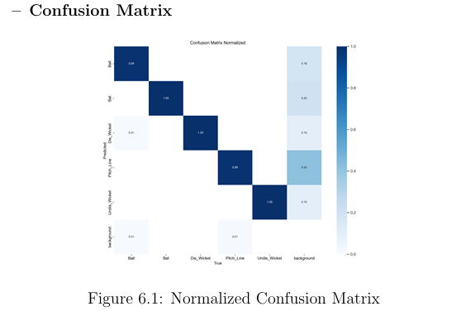
Evaluation: Compare predicted results with manual labels to compute standard performance metrics
Confusion matrix
It displays classification accuracy for each object class. Most classes — Ball, Bat, Disturbed Wicket, Undisturbed Wicket — have near-perfect accuracy, while the Pitch Line is correctly predicted 99.

Slide 21
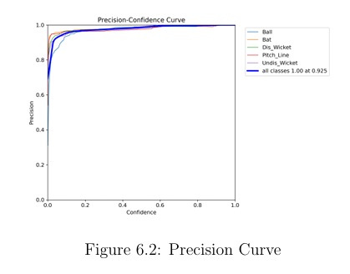
Precision
Explanation: Precision measures the fraction of relevant instances among the retrieved instances. The upward trend indicates the model is increasingly accurate at minimizing false positives as training progresses.

Slide 22
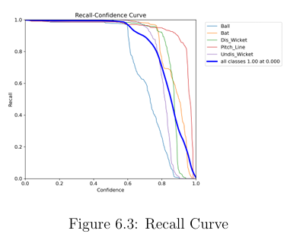
Recall
Explanation: Recall indicates the model’s ability to find all relevant cases (true positives). The curve’s rise towards 1.0 shows the model is effectively capturing most of the true positives, minimizing missed detec tions.

Slide 23
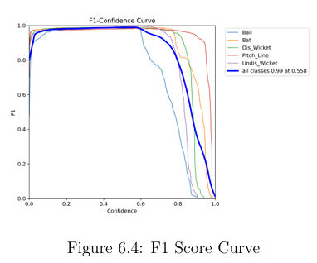
F1-score
Explanation: The F1-score balances precision and recall. The steady increase demonstrates improved balance between avoiding false positives and false negatives, reflecting the model’s growing robustness.

Slide 24
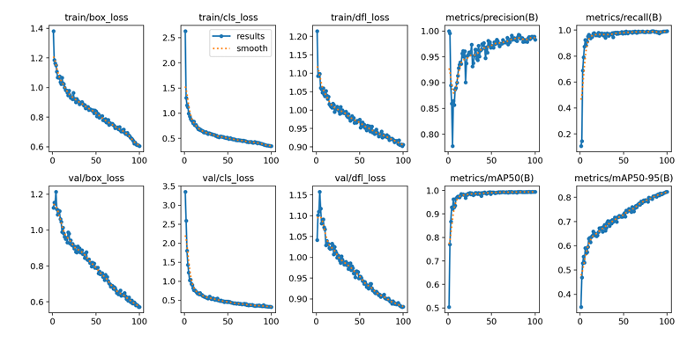
Result Visualization: Training and validation metrics were recorded and plotted over epochs to evaluate model learning progress and performance.

Slide 25
Train/box loss & val/box loss: Show how well the model learns to find bat, ball, and wickets. Lower = better!
Train/cls loss & val/cls loss: Show how well the model learns to name objects. Going down = getting smarter.
Train/dfl loss & val/dfl loss: Helps the model draw boxes more exactly. Lower = more accurate boxes.
Metrics/precision(B): Tells how many of the model’s answers are correct. Closer to 1 = less guessing wrong.
Metrics/recall(B): Tells how many real things (like ball or bat) the model actually finds. Higher = finds more!
Metrics/mAP50(B): Shows how good the model is overall. Closer to 1 = great job!
Metrics/mAP50-95(B): A harder test of how good the model is. Going up = doing well in all situations.

Slide 26
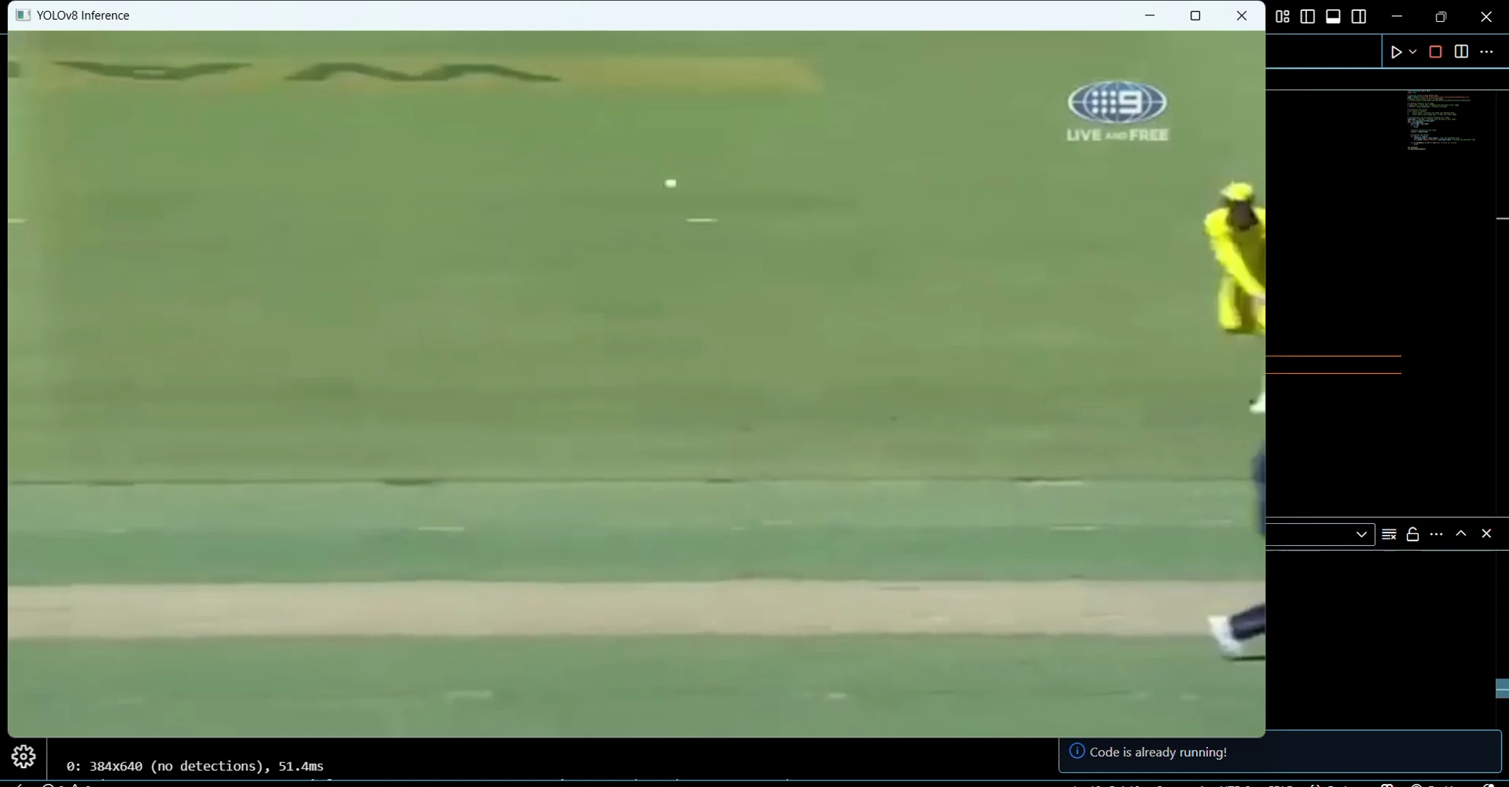
Inference Output/Working Model :

Slide 27
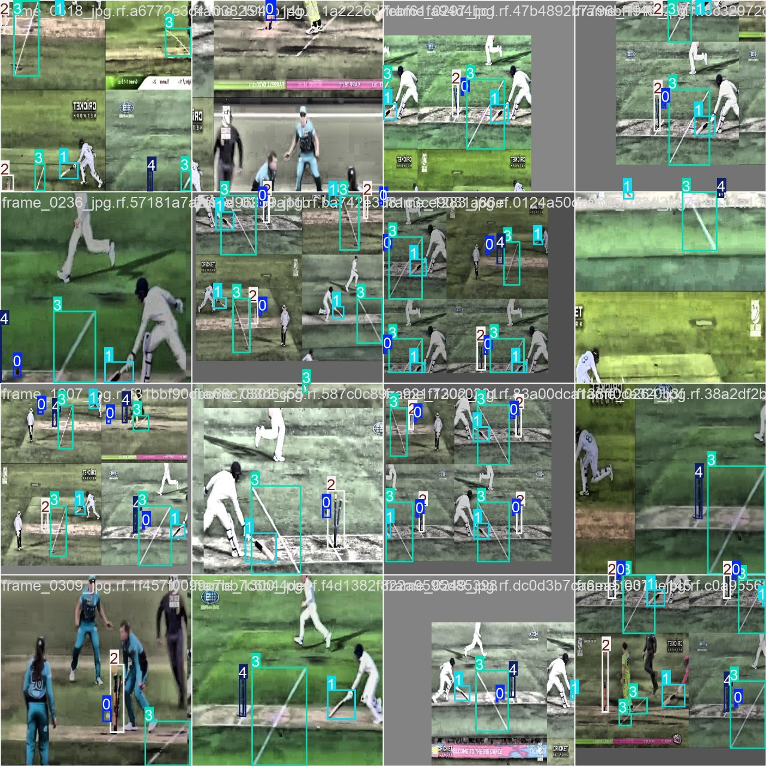
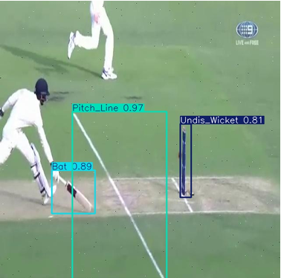
Resultant image :
The image displayed is the part of real time video footage where model is detecting the labels (bat, balls, wicket and pitchline) and predicting whether player is out or not.

Slide 28
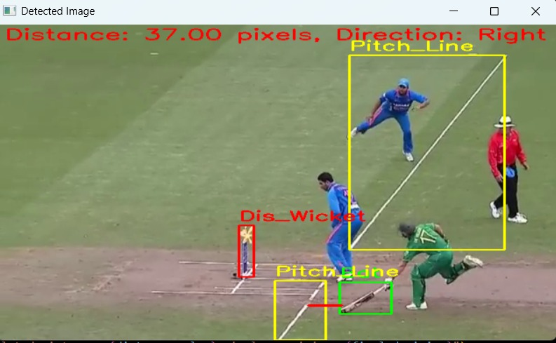
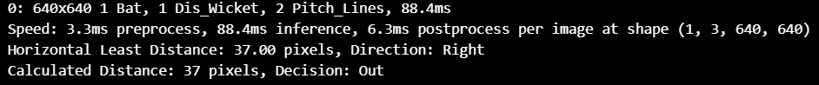
Model Predicting Run Out
Model is predicting run out using final code with gui.py file
Giving run out decision with label, distance and time to take to decide run out.

Slide 29
Benefits :
Improved Accuracy
Reduces subjectivity in decision making
Faster Decision Making
Provides real time feedback for quick decisions
Reduced Time
Reduces time to milliseconds in giving decisions.
Enhanced Fan Experience
Adds a new dimension to the viewing experience

Slide 30
Limitations :
The automated run-out detection system improves accuracy but faces challenges like motion blur, dataset dependency, hardware needs, environmental factors, and complex rule interpretations, requiring human oversight in critical cases
Future Scope :
The system can expand to automate stumpings, LBW, and boundary calls, integrate
with Hawk-Eye and UltraEdge, enable real-time deployment in live matches, and
leverage advanced AI models for improved accuracy.

Slide 31
Conclusion :
The automated run-out detection system enhances accuracy, reduces human error, minimizes decision delays, and ensures fair play, making cricket officiating more efficient and reliable with the potential for future advancements.
References :
1 .Collecting videos from online sources
2. Research paper of the designated persons
Automated Third Umpire Decision Making in Cricket Using Machine Learning TechniquesGanesh Neelakanta Iyer, Member IEEE, Bala Vignesh S, Bommidi Sohan, Dharmesh R, Vishal Raman Department of Computer Science and EngineeringAmrita School of Engineering, Coimbatore, Amrita Vishwa Vidyapeetham, India
Automating Runout Decisions In Cricket Using Image Processing Sabarish B A 1, Sheethal Mohan2, D P MamthaShri3 ,Rishikesh C Ajit4, A VR Arun51Assistant Professor Department of Computer Science and Engineering, Amrita School of Engineering, Amrita Vishwa Vidyapeetham (University), Coimbatore - 641 112.{2,3,4,5}Final year B.Tech,Computer Science and Engineering Student Amrita School of Engineering, Amrita Vishwa Vidyapeetham (University), Coimbatore - 641 112.1sabarishpm@gmail.com, 2sheethalmohan93@gmail.com, 3shri.mamtha@gmail.com 4rishikesh.ajit@yahoo.in, 5avrarun2511@gmail.com

Slide 32
Thank You !!

